Slide 1
Capstone Project-2
(Employee Churn Prediction)
Group-11
F-1295 Victor
F-1380 Habip
F-1470 Aziz
F-1491 Brian
F-1328 Fırat
F-1382 Halil

Slide 2
Table of Contents
Introduction to Employee Churn
Key Takeaways and Assumptions
EDA
Data Visualization
Data Pre-Processing
Cluster Analysis
Model Building
Model Deployment

Slide 3

Introduction to Employee Churn
In customer churn, you can predict who and when a customer will stop buying.
Employee churn is similar to customer churn.
It was found that employee churn will be affected by age, tenure, pay, job satisfaction, salary, working conditions, growth potential and employee’s perceptions of fairness.
Some other variables such as gender, ethnicity, education, and marital status were essential factors in the prediction of employee churn.
In some cases such as the employee with niche skills are harder to replace.
Acquiring new employees as a replacement has its costs such as hiring costs and training costs.
Organizations tackle this problem by applying machine learning techniques to predict employee churn, which helps them in taking necessary actions.

Slide 4


Introduction to Employee Churn
Business chooses the employee to hire someone while in marketing you don’t get to choose your customers.
Employees will be the face of your company, and collectively, the employees produce everything your company does.
Losing a customer affects revenues and brand image. Acquiring new customers is difficult and costly compared to retain the existing customer. Employee churn also painful for companies an organization. It requires time and effort in finding and training a replacement.
Employee churn has unique dynamics compared to customer churn. It helps us in designing better employee retention plans and improving employee satisfaction. Data science algorithms can predict the future churn.

Slide 5
Key Takeaways and Assumptions
A Clean DF (How lucky we are!🙏).
There are no duplicated value.
There are remarkable amount of niche employees.
Clustering does not work for our project.
XGBoost Model
Model Deployment —> Streamlit

Slide 6
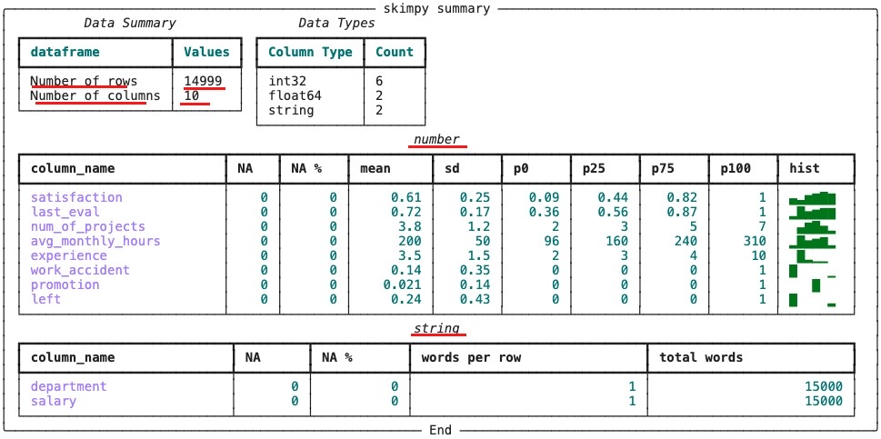
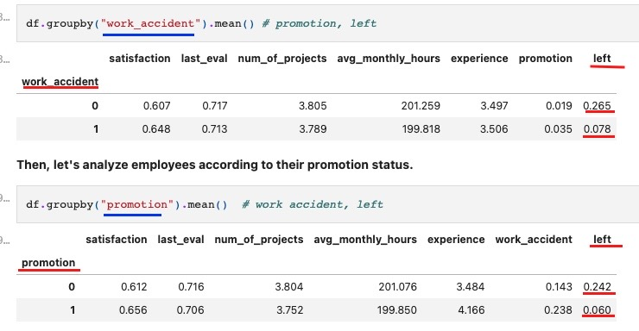
EDA
1.
We chose not to delete duplicated rows
2.
“groupby” function by [“work_accident”, “promotion”, “department”, “salary”, “left”]
3.

Slide 7
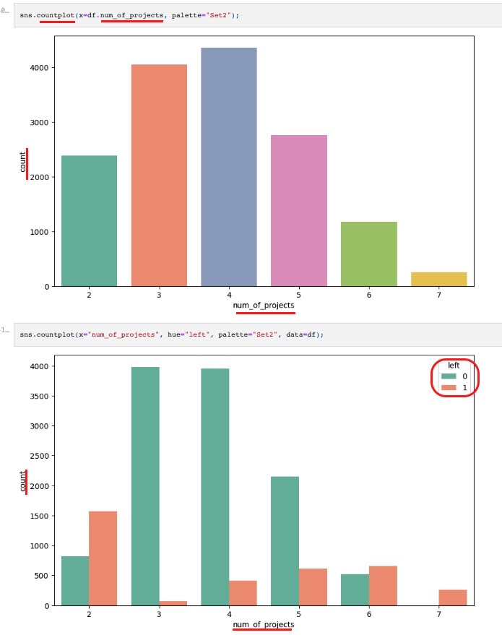
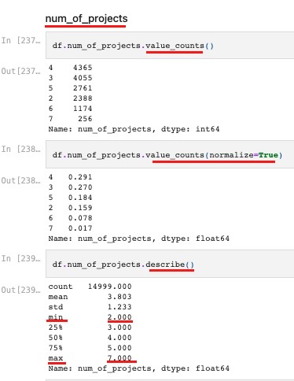
EDA
Analyze df column by column

Slide 8
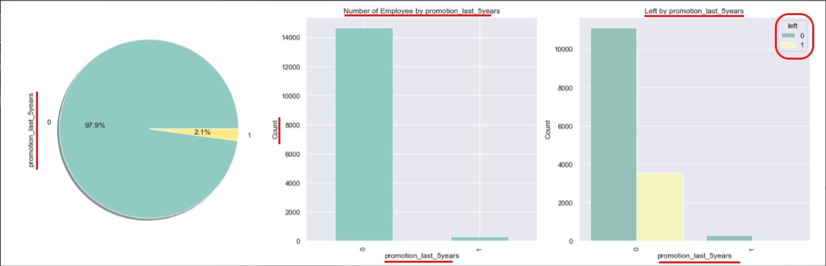
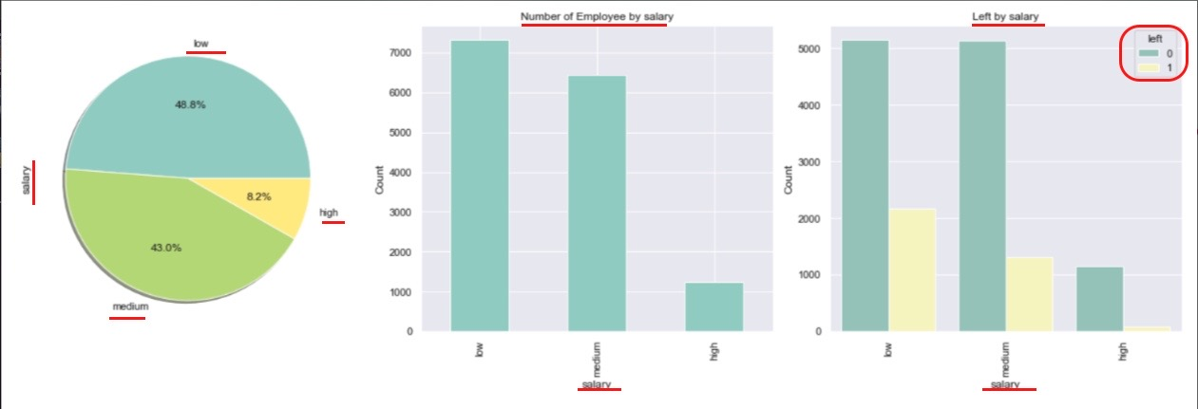
Data Visualization
1.
2.

Slide 9
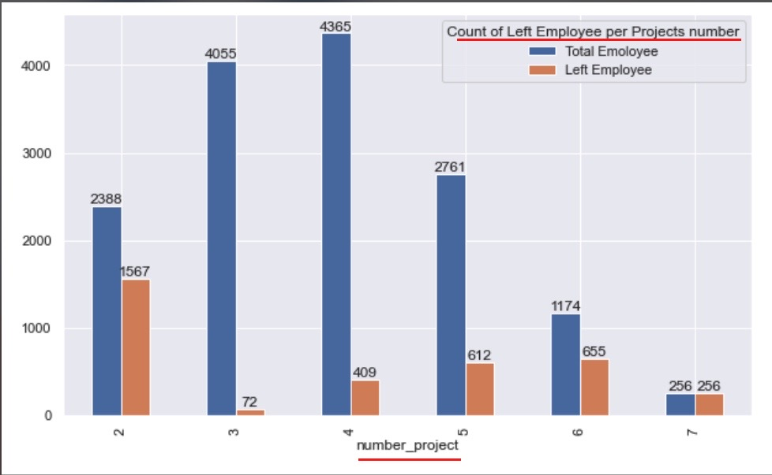
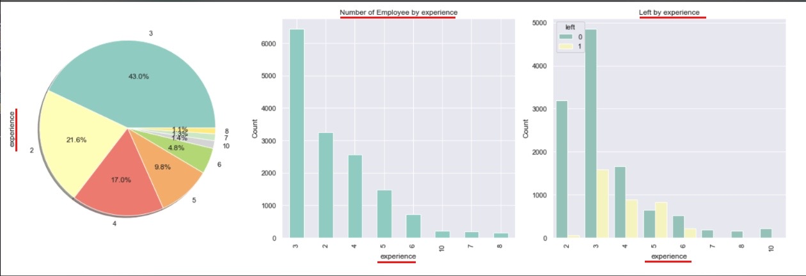
Data Visualization
1.
2.

Slide 10
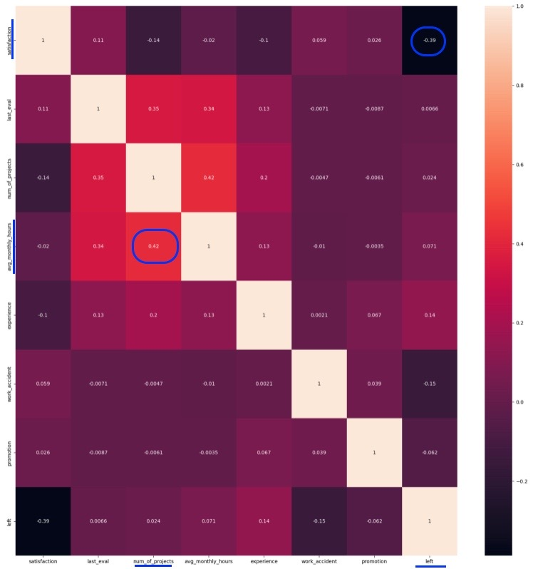
Data Visualization

Slide 11
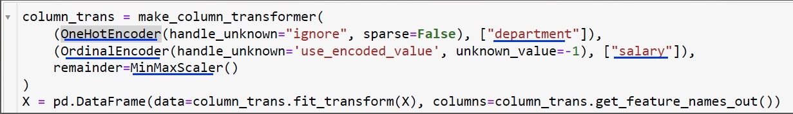
Data Pre-Processing
OneHotEncoder [“department”]
OrdinalEncoder [“salary”]
MinMaxScaler —> Remainder

Slide 12
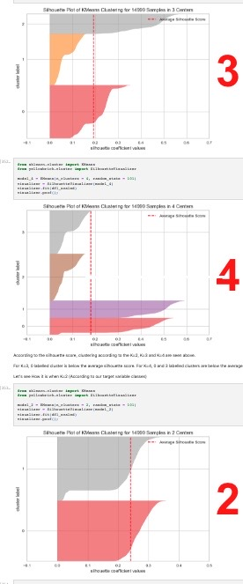
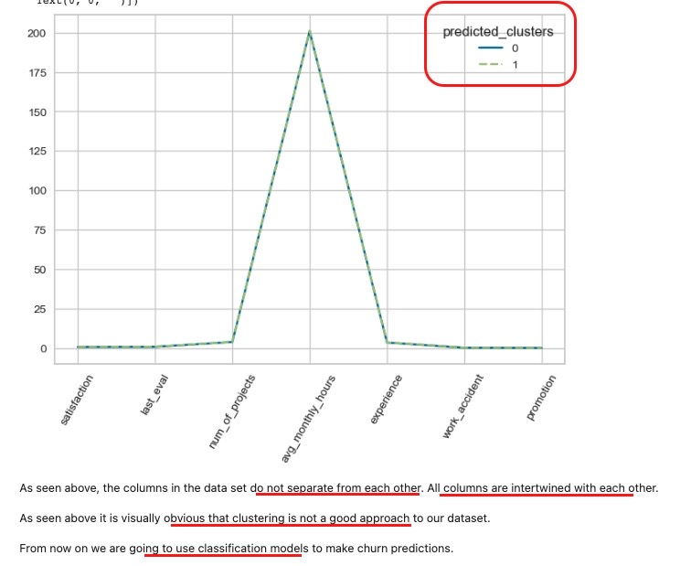
Cluster Analysis

Slide 13
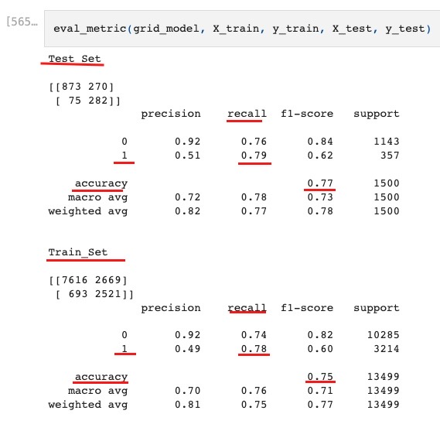
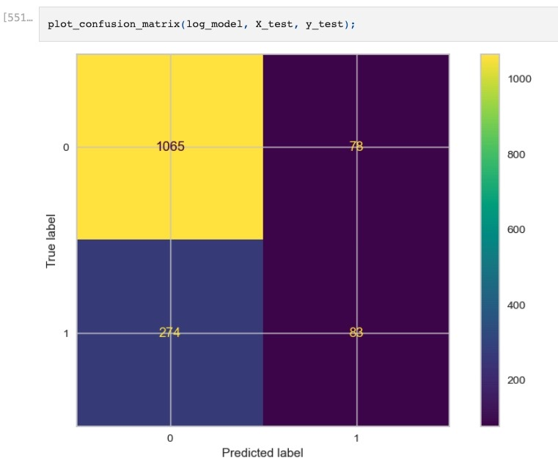
Model Building
Logistic Regression

Slide 14
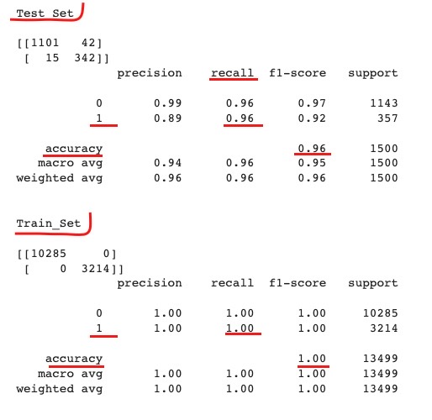
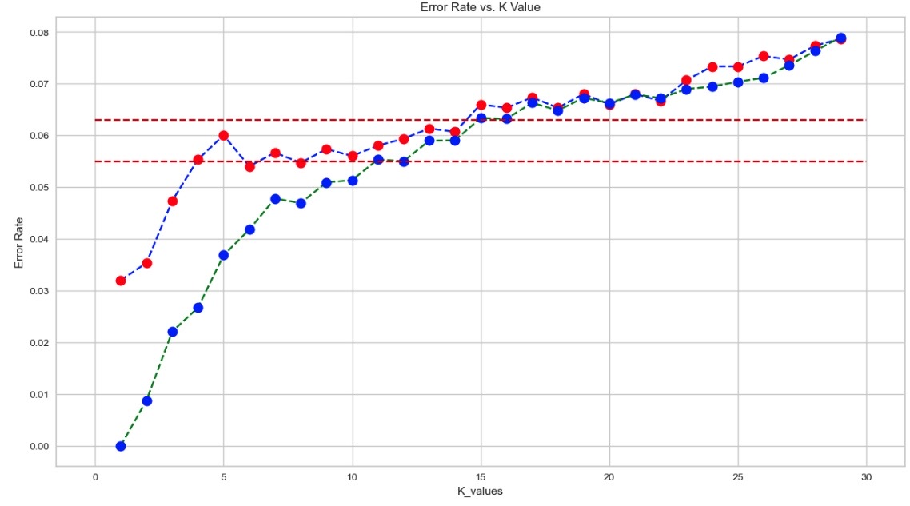
Model Building
KNN

Slide 15
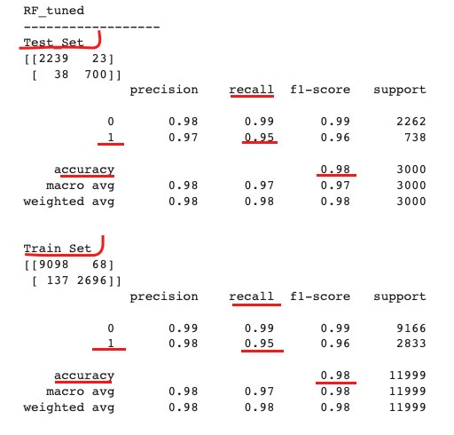
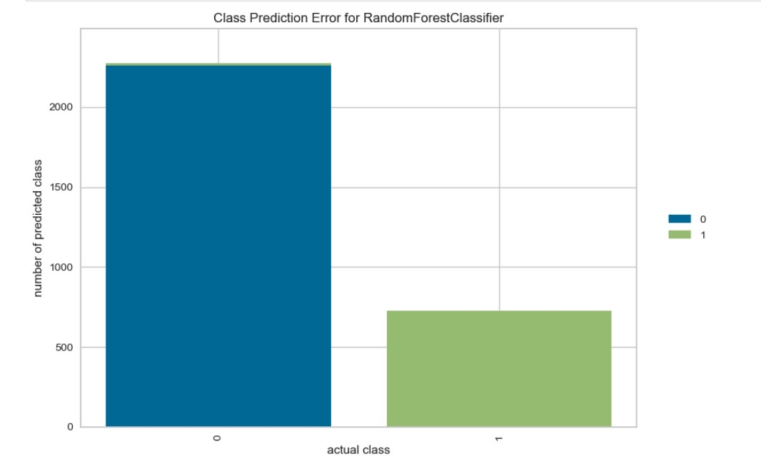
Model Building
RainForest

Slide 16
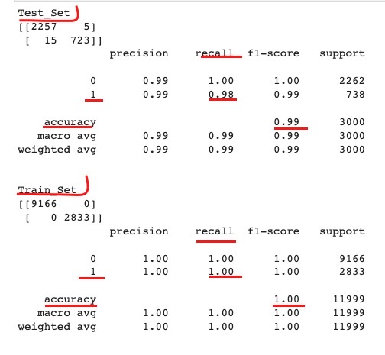
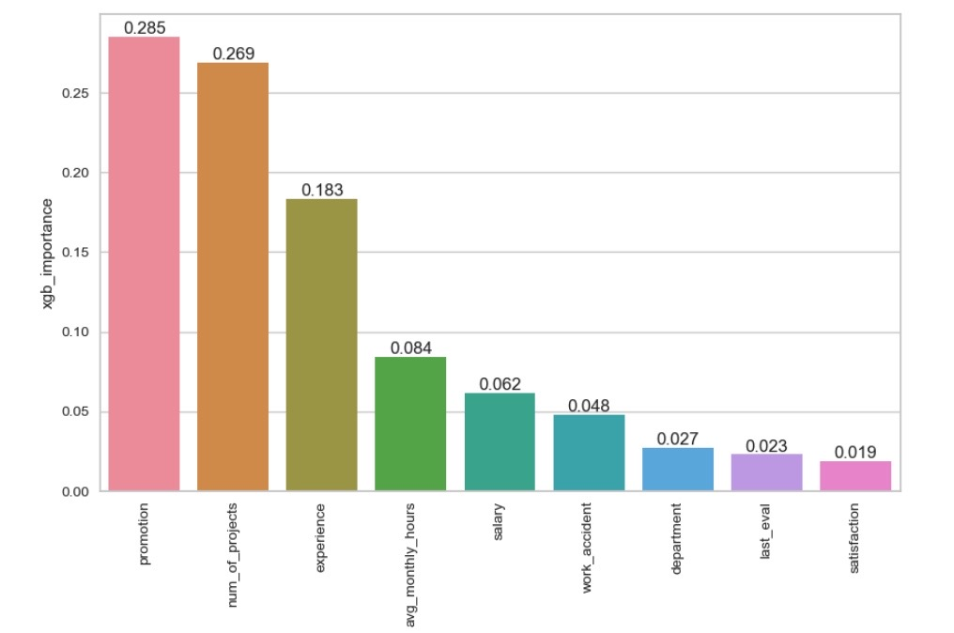
Model Building
XGBoost

Slide 17
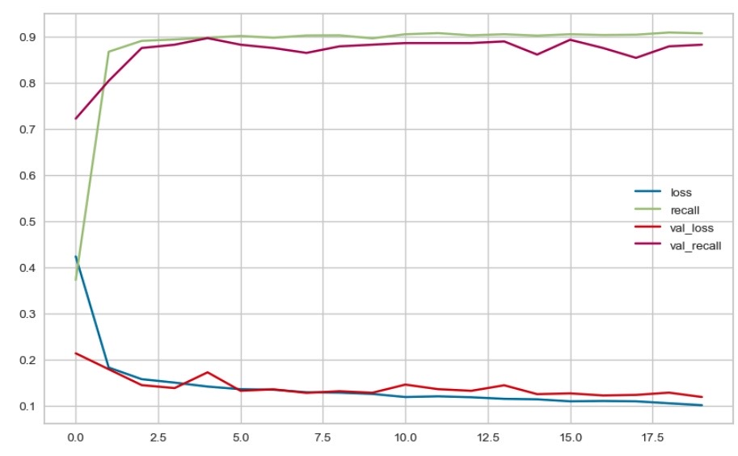
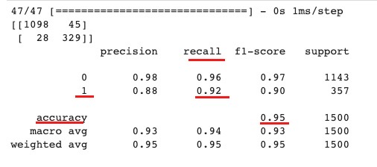
Model Building
ANN

Slide 18
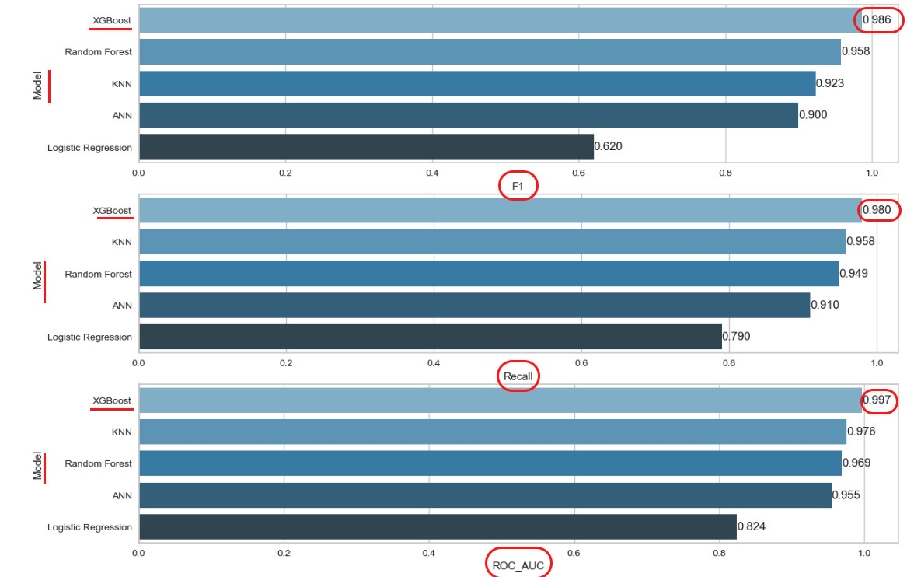
Model Comparing

Slide 19
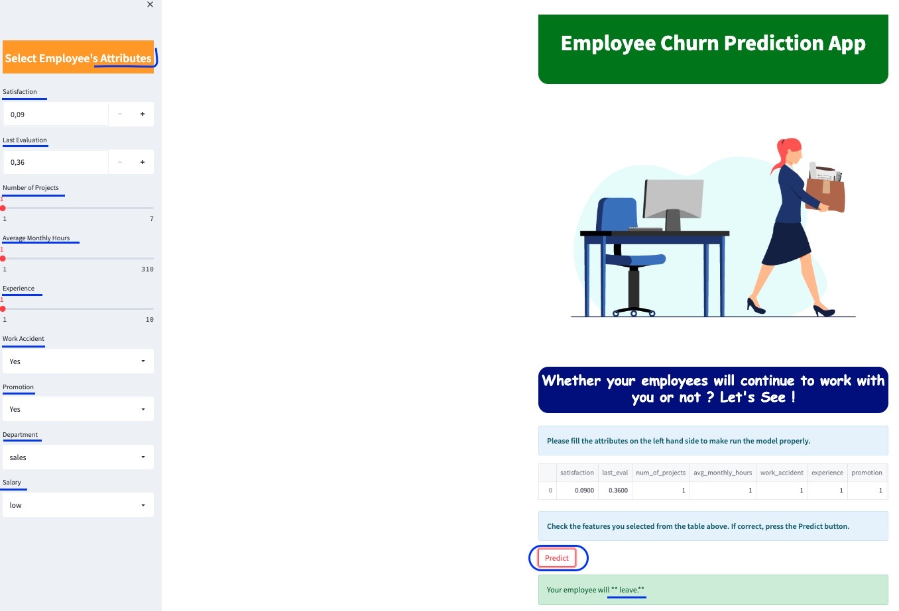
Model Deployment

Slide 20
Any question/feedback?
Thank you!

